Slide 1
A Golden Opportunity
Private & Confidential
To Acquire Perfect Radiators and Oil Coolers Private Limited
(Under the framework of IBC, 2016)
Company: Perfect Radiators and Oil Coolers Private Limited
RP - Bhoopesh Gupta
Resolution Professional
Regn No. IBBI/IPA-001/IP-P01468/2018-2019/12271
Website: https://www.perfectcirp.in/
1

Slide 2
Company Profile
Company Information:
PERFECT RADIATORS AND OIL COOLERS PRIVATE LIMITED
CIN : U34300DL2003PTC120935
Date of Incorporation : 16th June 2003
Registered Office : B-10/1, OKHLA INDUSTRAIL AREA PHASE II, NEW DELHI, Delhi, India, 110020
Board of Directors
Mr. RAGHAV BUTOLA
Ms. BRIJESH KUMAR SHUKLA
Note: Under IBC Process, Order for Commencement of Corporate Insolvency Resolution Process (CIRP) initiated by Hon'ble NCLT Allahabad Bench vide its order dated 07th Jan, 2026.
2

Slide 3
Project Details
Factory location : Khasra No. 11-12, Factory land and building at Village Nizampur, Tauru-Rewari, Distt. Mewat (No activity since 2021)
Engaged in Business : MANUFACTURER OF PARTS AND ACCESSORIES FOR MOTOR VEHICLE AND THEIR ENGINES
Past History : Perfect radiators earlier engaged in the business of manufacture of copper-brass/aluminium brazed heat exchangers for automotive, industrial and locomotive applications and shell and tube heat exchangers and oil coolers, and investing in various companies.
Interested parties can reach out at cirp.perfect@gmail.com or can contact Mr. Suraj (Company Secretary) at 9643161757
3

Slide 4
PUBLICATION OF FORM G-INVITATION FOR EXPRESSION OF INTEREST
Public advertisement was made on 07.03.2026 in Financial Express (English), Jansatta (Hindi), for inviting Expression of Interest “EOI” for resolution of the Corporate Debtor.
Last Date for Receipt of EOI: 24.03.2026
Last Date of Submitting Resolution Plan: 25.05.2026

Slide 5
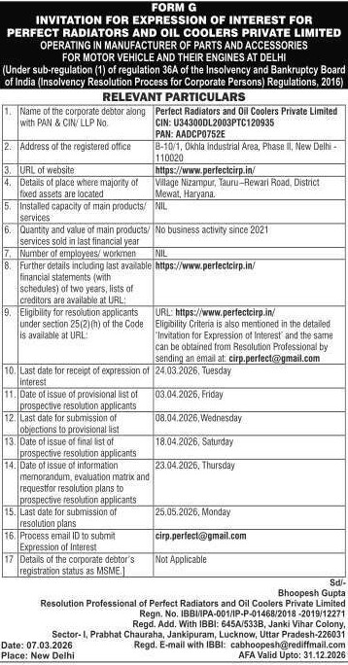
PUBLICATION OF FORM G-INVITATION FOR EXPRESSION OF INTEREST
Publication in Jansatta- (Hindi) & Financial Express-English
Date of Publication 07.03.2026
Form G: Click Here

Slide 6
Disclaimer
The information contained/disclosed in the Flyer is as provided by the Corporate Debtor and the creditors of the Corporate Debtor. No representation or warranty, express or implied, is given by the Corporate Debtor, any of its Officers, Employees or its Agents or the Resolution Professional or his team as to the accuracy, authenticity or completeness of the contents of this Flyer or any other document or information supplied, or which may be supplied at any time or any opinions or projections expressed herein or therein, nor is any such party under any obligation to update the Flyer or correct any inaccuracies or omissions in it which may exist or become apparent.
For clarification, if any, please contact Mr Suraj (Company Secretary) at 9643161757 or the undersigned at the address given below.
AVM Resolution Professionals LLP
Phone: 011-41486026/27
Email ID: cirp.perfect@gmail.com
Add: 3rd floor, 8/28, WEA, Abdul Aziz Road, Karol Bagh, New Delhi, 110005

Slide 7
Thank You

